Slide 1
Function Calls in Stack

Slide 2
Overview
Function call stack in C is a dynamic data structure where elements are stored at contiguous memory locations. Function call stack is maintained for every function call where it contains its own local variables and parameters of the callee function.
In fact, the function call stack also stores the return address of the function itself. Function call stack in c is widely used in many applications like recursion and calling functions.

Slide 3
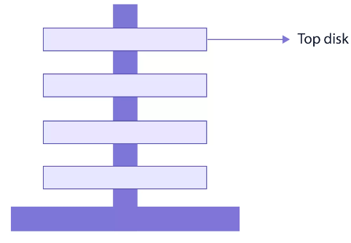
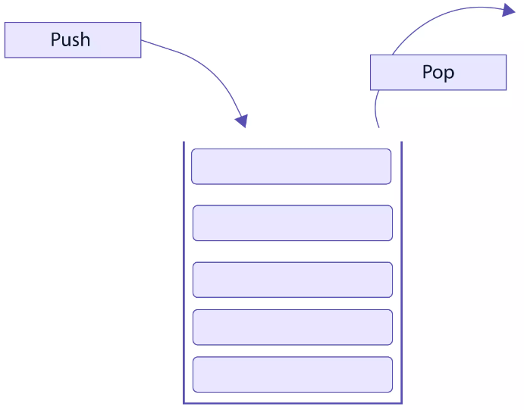
What are Stacks in C?
In C, stack is a Linear Data Structure where elements are stored at contiguous memory locations.
Stack follows the LIFO mechanism, i.e. Last in First Out. Let’s understand LIFO mechanism more clearly by an example.
In tower of Hanoi, all the disks are placed on a peg. It must be placed on the top of the peg to insert a new disk.
The top disk must be removed from the peg before removing any other disk, this is the LIFO mechanism.

Slide 4
What is Call Stack ?
Call stack is a dynamic data structure maintained inside the RAM memory by the Operating System.
Primary task of Function Call Stack in C is to manage the function calls and how they pass parameters to each other.
A call stack is maintained for each task and for each thread. It is also called an execution stack or machine stack. More often, it is simply known as a stack.
Now let’s look at how function calls are actually organized in a stack: Let’s assume we have two functions f1() and f2() along with main().
#include<stdio.h>
void f2() {
return;
}
void f1() {
f2(); //calling f2()
return;
}
//This is main function
int main() {
f1(); // calling f1()
}

Slide 5
Activation record: When a function calls another function, an entry is pushed to the stack. This entry is called as Activation Record.
Activation record contains parameters, local variables, and return address that the called function needs to return to the calling function.
On running the program, the main() is called, so an activation record for main() is created and added to the stack.
Now, main() calls f1(), which creates an activation record for f1() on top of stack and f1() calls f2() by adding activation record for f2() on top of stack.
When f2() terminates, its activation record is removed from the stack.
After completing the execution of f1(), it returns by removing the activation record from the stack.
At this stage, we are back to our main() which removes its activation record leading to the termination of the program.

Slide 6
Working of the Function Call
Now, whenever a function is called, a new stack frame is created with all the function’s data, and this stack frame is pushed into the program stack, and the stack pointer that always points to the top of the program stack points to the stack frame pushed as it is on the top of the program stack.
The series of operations when we call a function are as follows:
Stack Frame is pushed into the stack.
Sub-routine instructions are executed.
Stack Frame is popped from the stack.
Now Program Counter is holding the return address.
Note: POP instruction in assembly language removes the top of the stack and assigns it to the program counter.

Slide 7
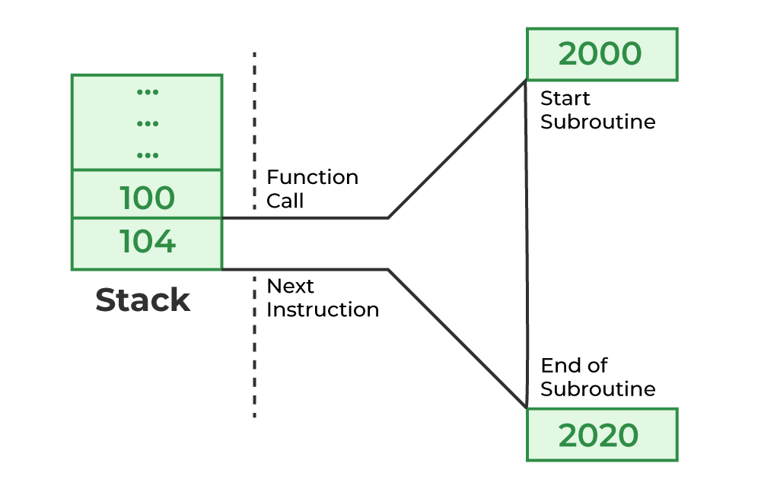
Example of Function Call
In the given diagram of instance of calling a function.
Program counterpoints to the next instruction memory location i.e., 104 before executing a function whereas 100 is the memory location of the calling function.
To restore the return address, the contents of the Program Counter are pushed into the stack. Now address stored at the top of the stack is 104.
Calling function Execution: Now Program Counterpoints to 2000 which is the starting address of the subroutine. After execution of all successive instructions in the subroutine, the address is popped from the stack.
Popping off the stack refers to removing the top of the stack and assigning it to the Program Counter. Now Program Counter is holding the return address i.e., 104.

Slide 8
Sample code for Function call
#include<stdio.h>
//This is fun2() with one parameter
int fun2(int i)
{
int j;
return j;
}
// This is fun1() with two parameters
int fun1(int x, int y)
{
int a;
int b;
b = fun2(a); //calling `fun2()` from fun1()
return b;
}
//This is main() function
int main()
{
int c = fun1(10,30); // calling fun1() from main()
}

